Slide 1
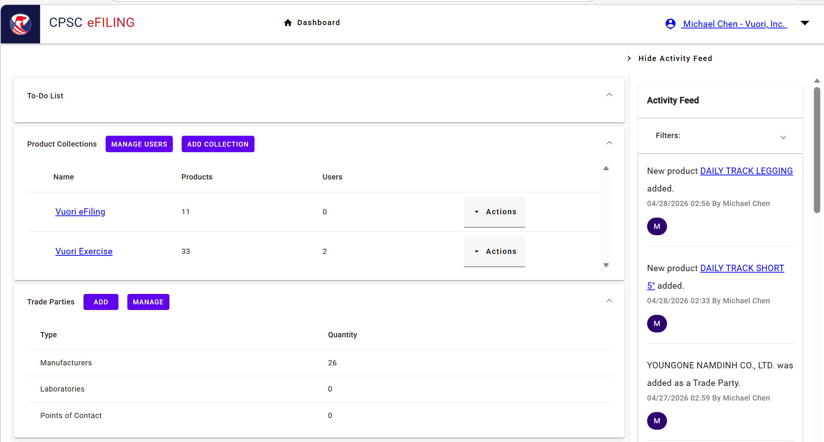

Click on it for Creating a “Collection” that you could “Name” it

Slide 2
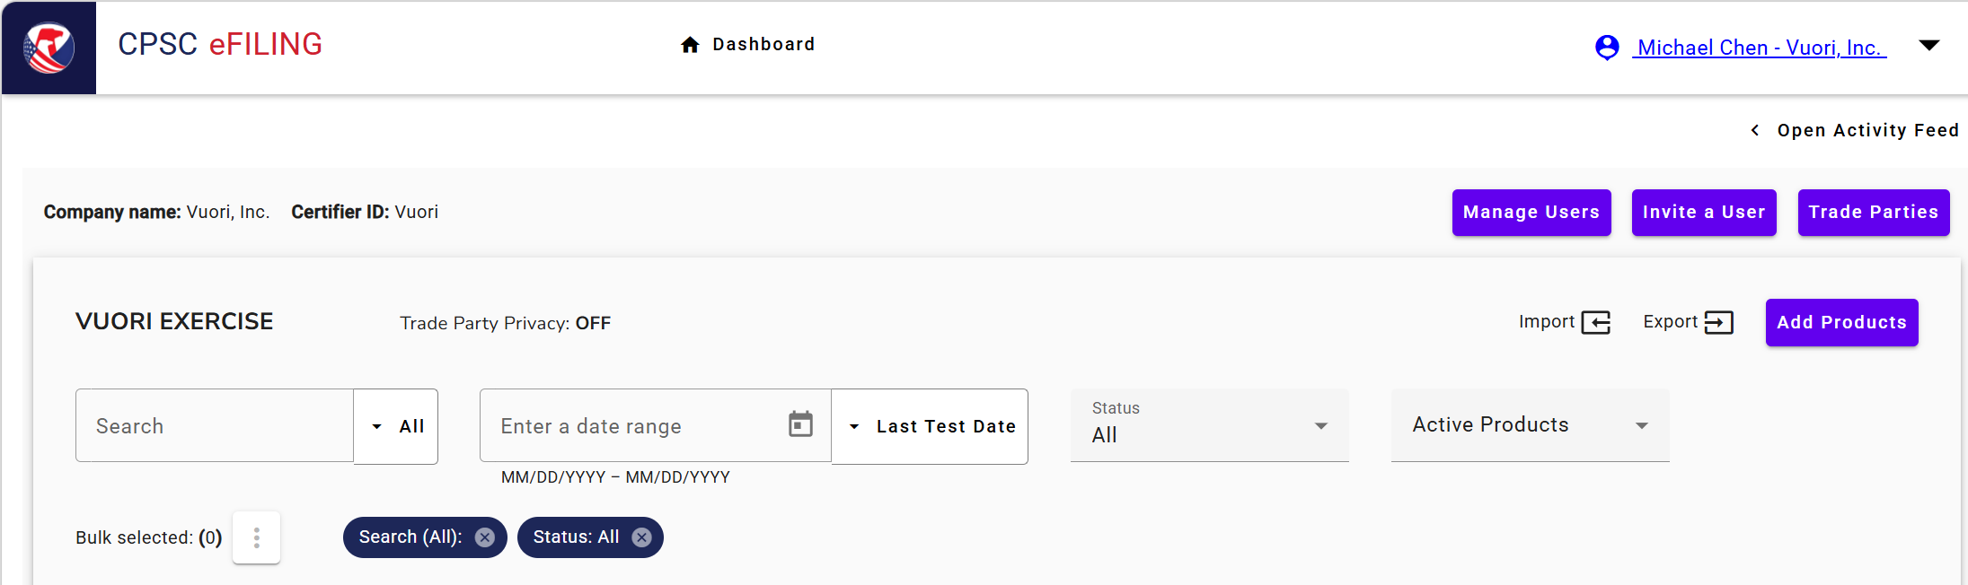
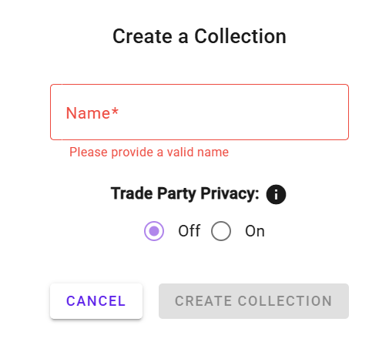
Click on it for “Adding Products”
Such as
Test1

Slide 3
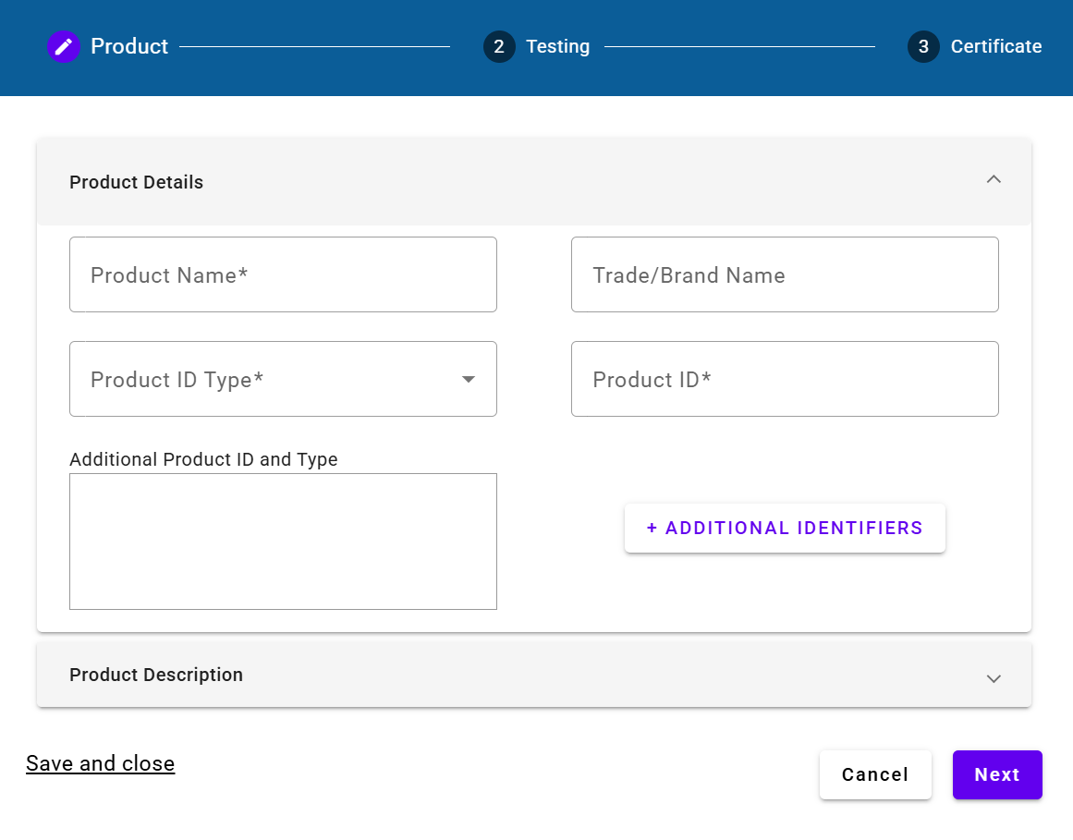
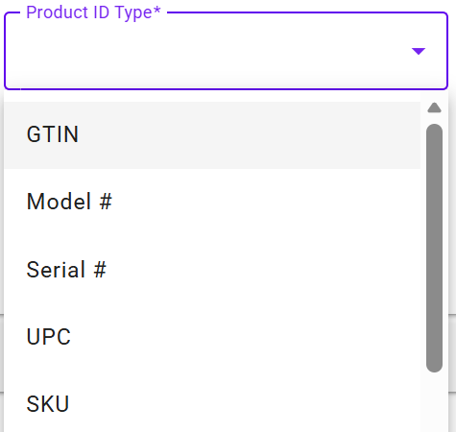
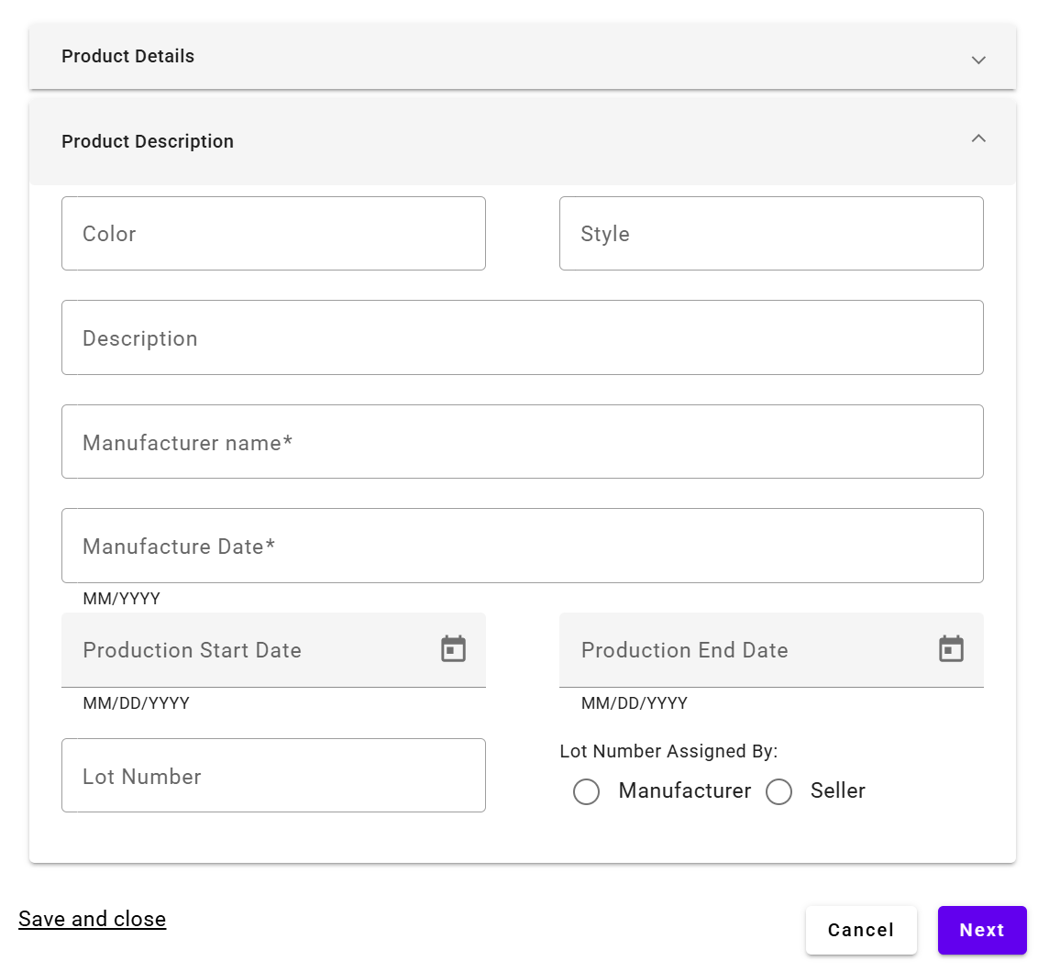


From the dropdown list, select “Model #”
Ex: S/S STRATO BREATHE TEE
VUORI
Model #
V1150
Click on this for “Adding New Trade Party”

Slide 4
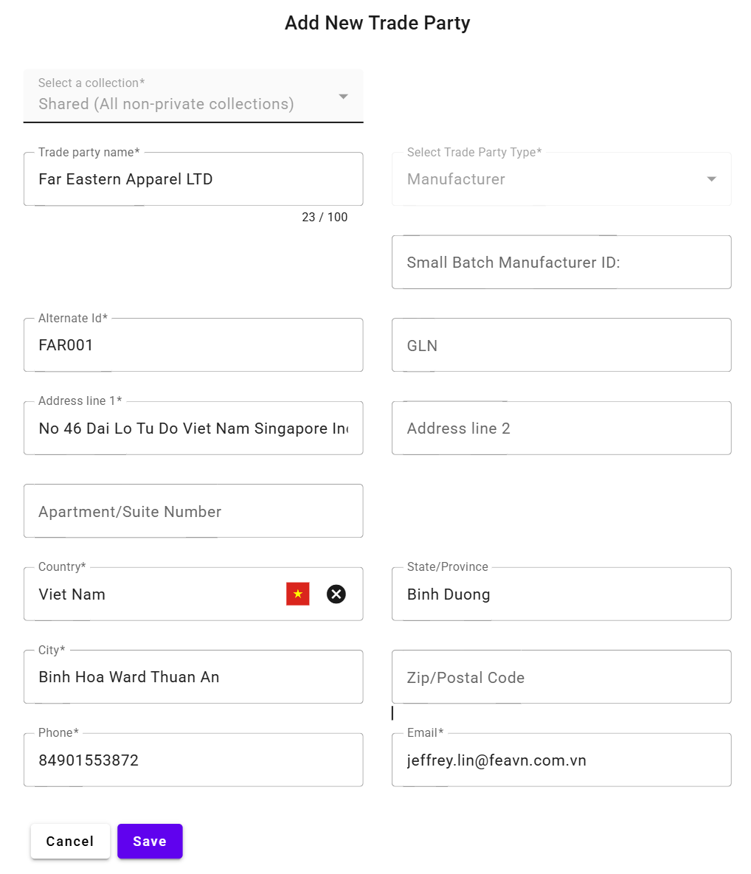
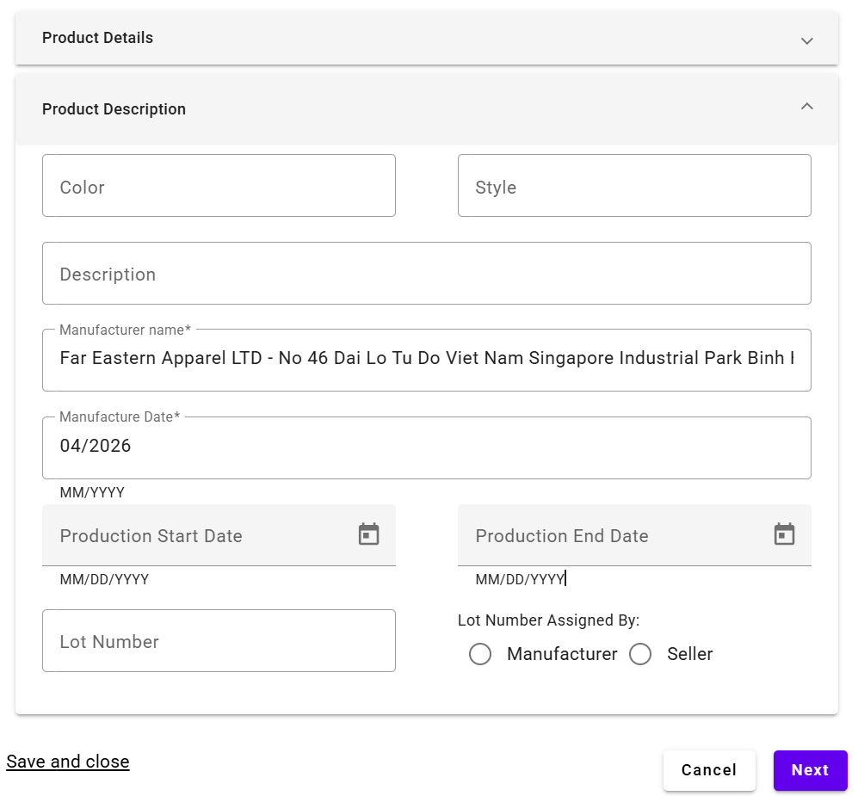








Fill out these* = Mandatory Info.
The Manufacturer name will be on your list
Please mind the format – must be month/year
Click on “Save”

Slide 5
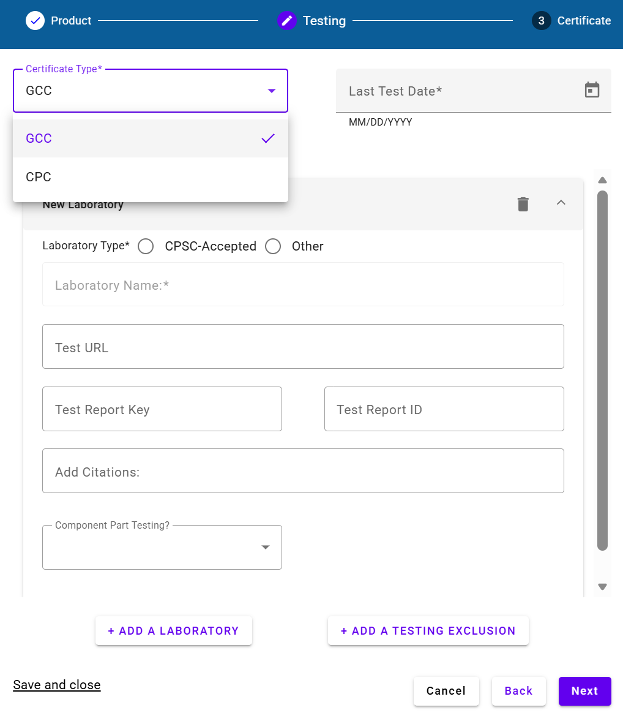
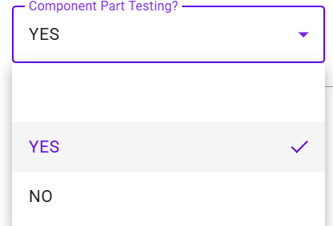




It’s the Test Report Date
E.X: 03/02/2026

Slide 6
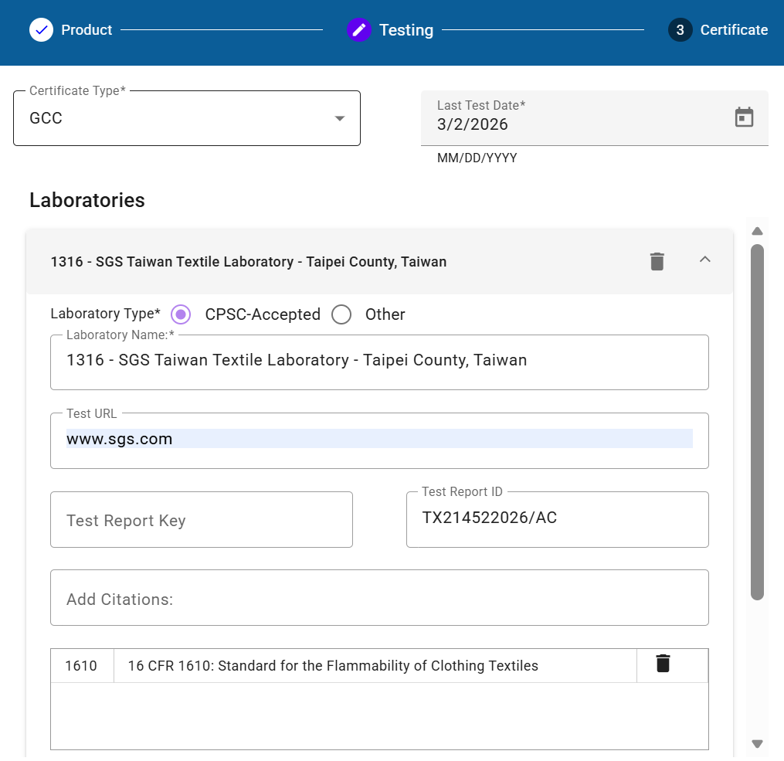
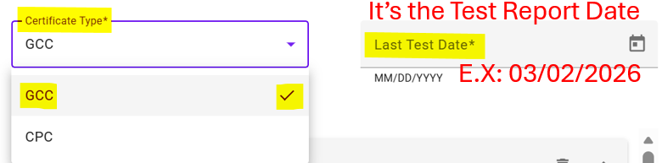
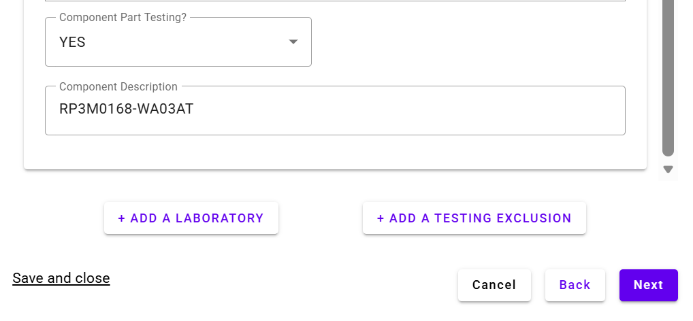

















Where the Test Report Issued
It’s also a dropdown list, e.x: 1316 – SGS Taiwan Textile Lab. Taipei County, Taiwan
Since we nominated SGS, so just type www.sgs.com
Test Report ID = Test Report #
Add Citations: It’s also a dropdown list – just type “1610” for quick selection
Component = Fabric
It’s another dropdown list, just select “Yes”
Component Description = Fabric Article # that applied on this apparel - pls fill out accordingly

Slide 7
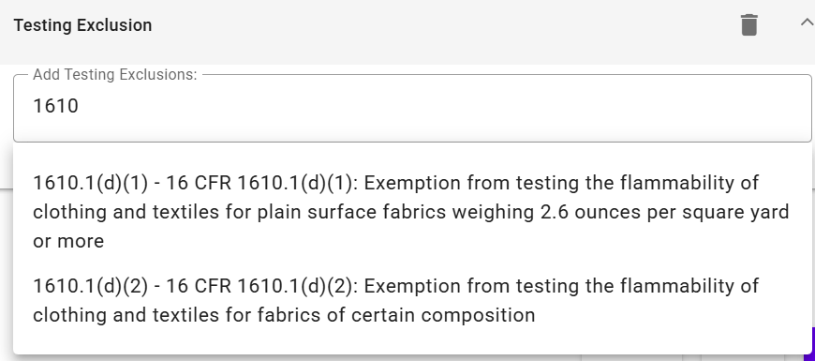
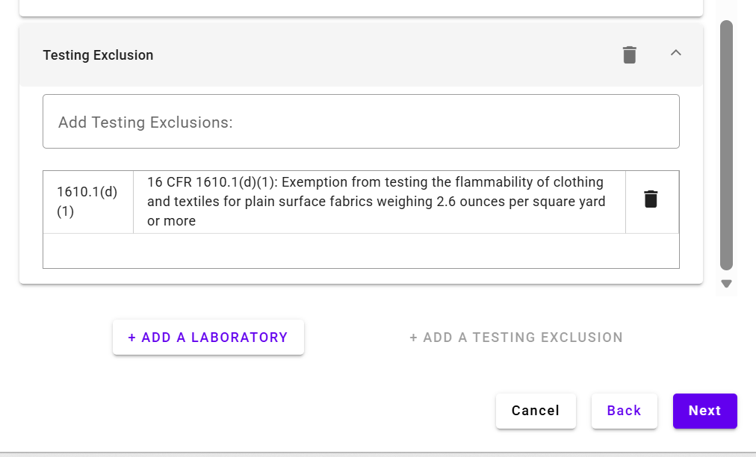










Type “1610” then, 2 dropdown options:
E.X: Select one by clicking on it:
Click on “Next”

Slide 8
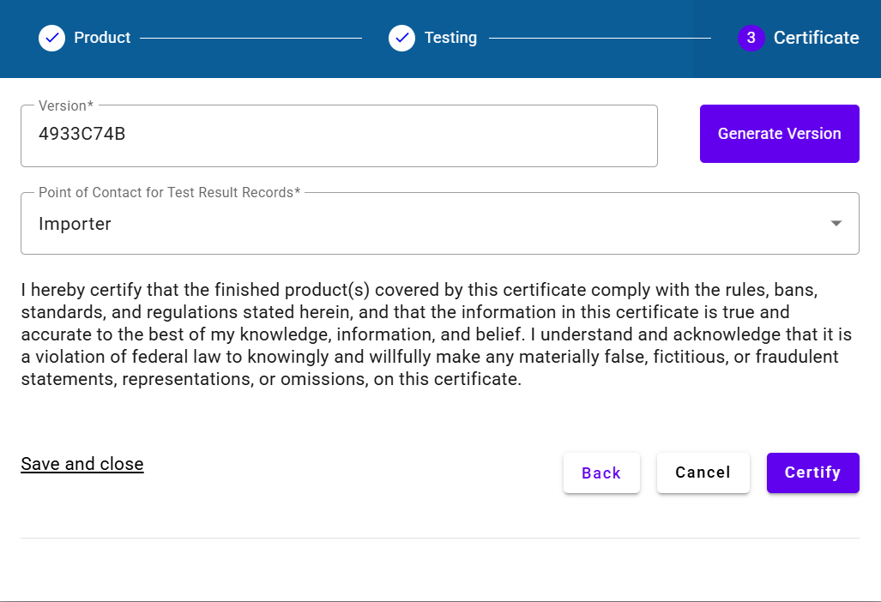
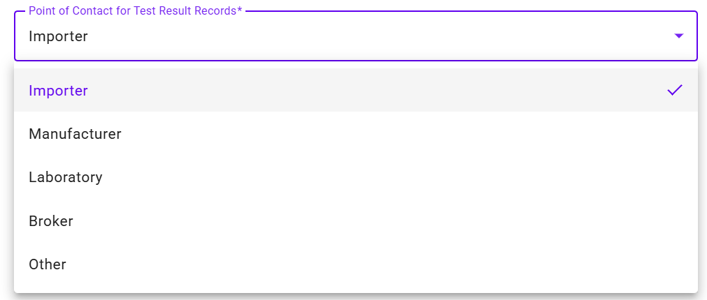








Click on it – Version ID will be Generated automatically
Dropdown list for selecting “Importer”
When you see the “Certify” is on Purple color
Meaning – All Set – Ready to Certify

Slide 9
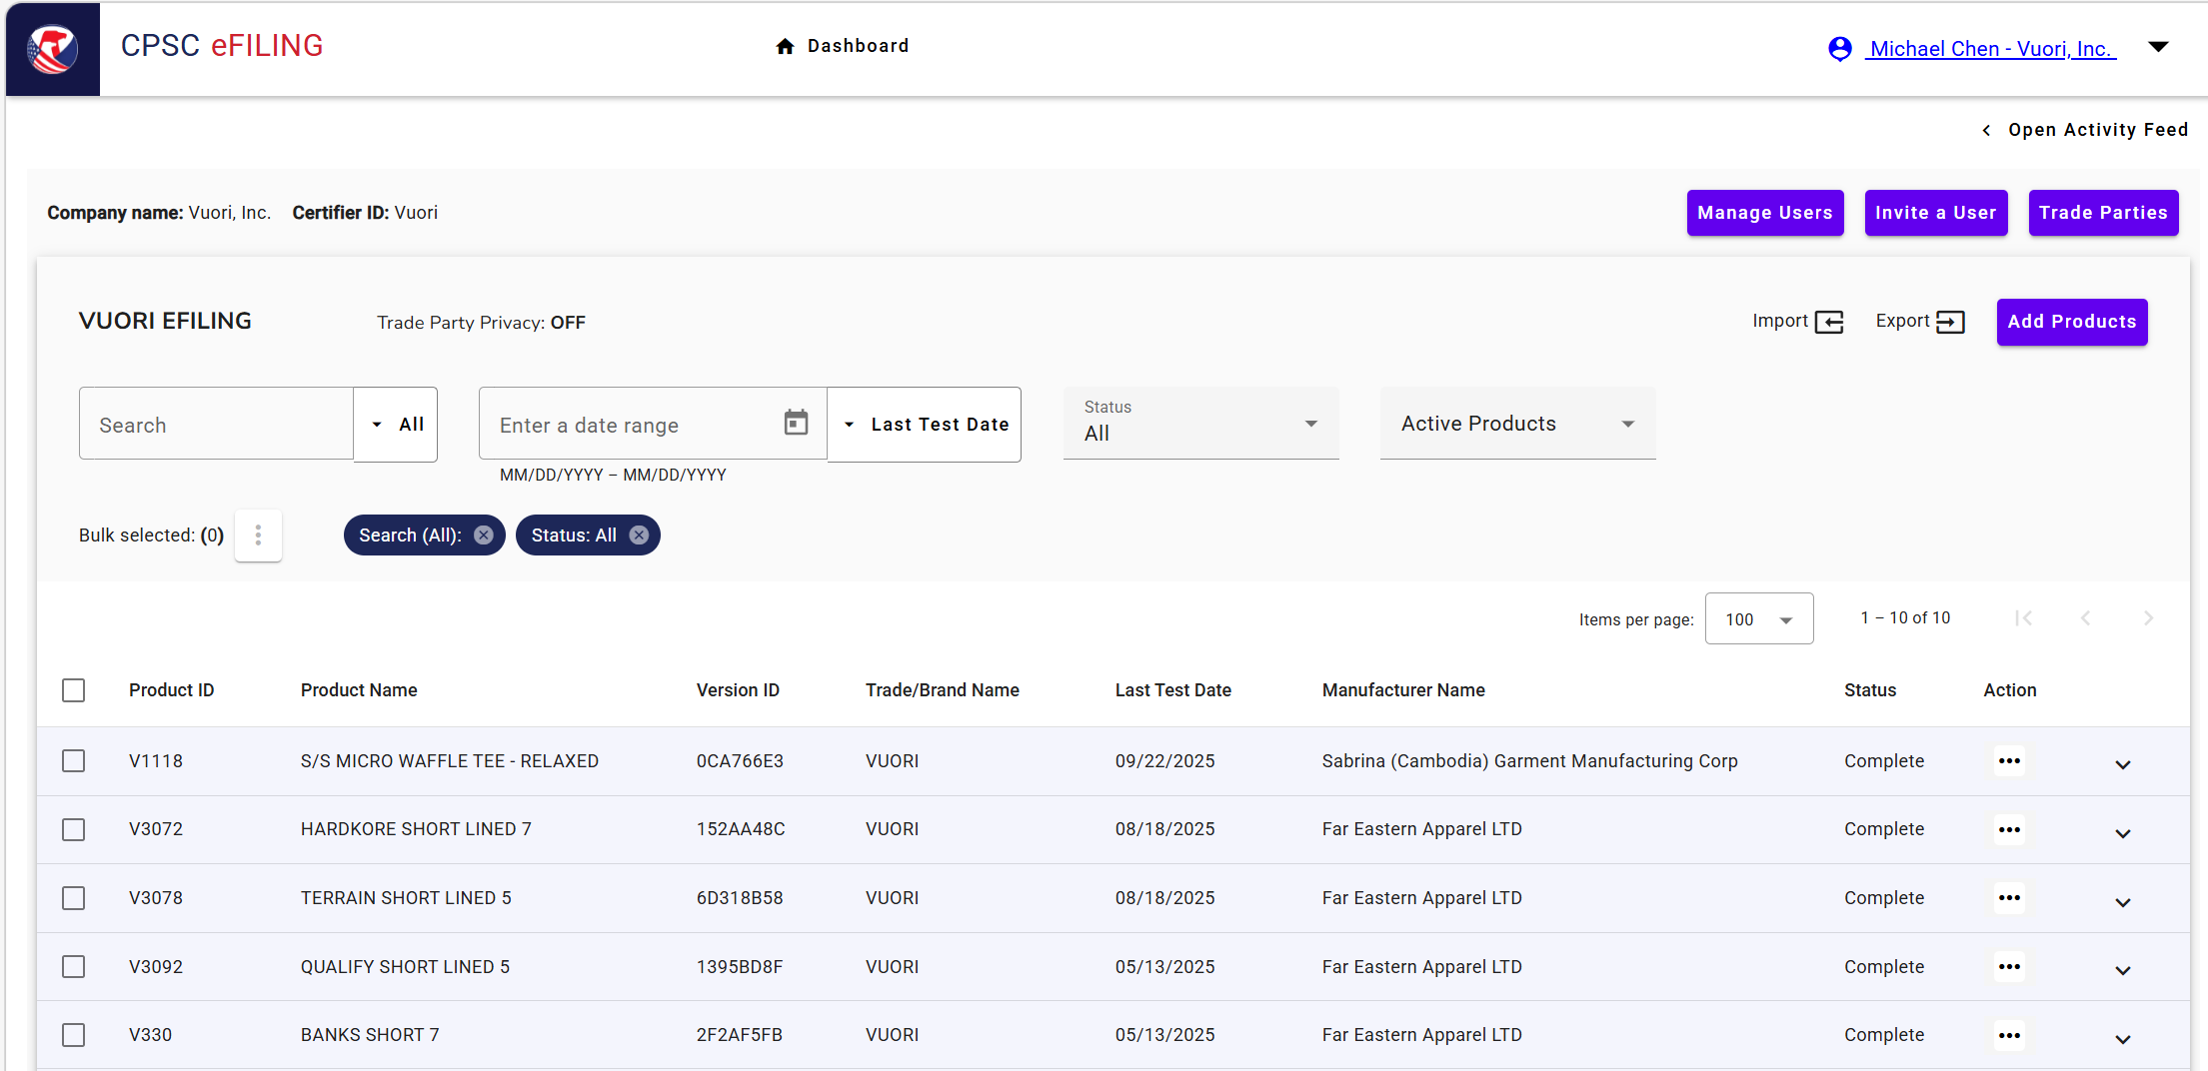
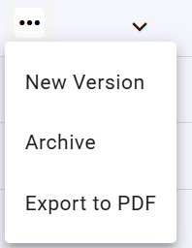

A
B
A-1
It’s for GCC downloading

Slide 10
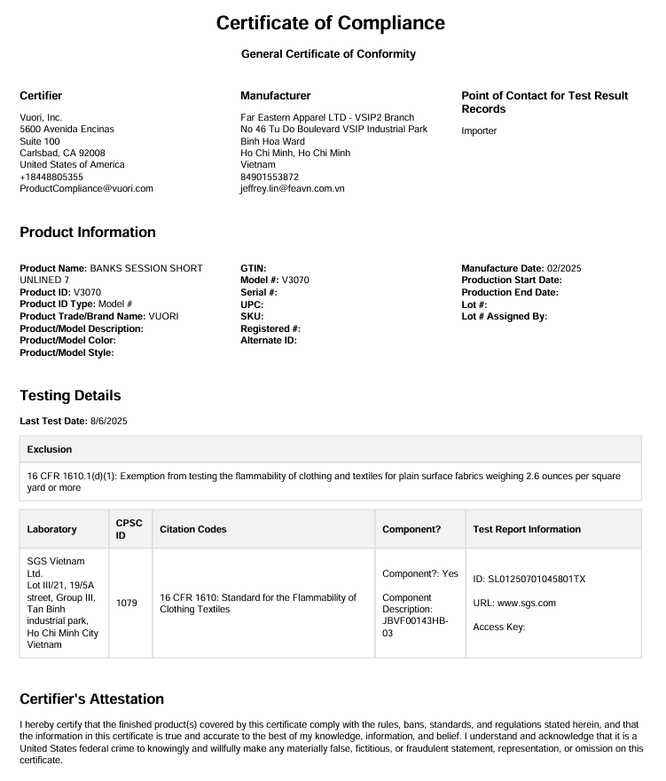

















GCC generated by ACE Platform – e.x
A-2
A-3

Slide 11
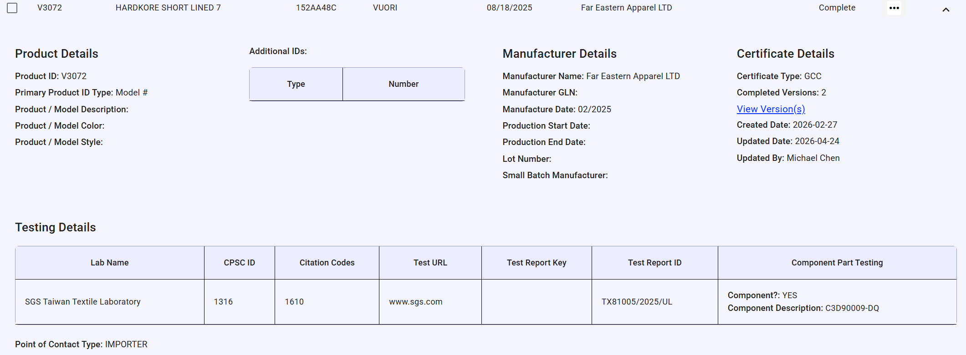








B-1

Slide 12
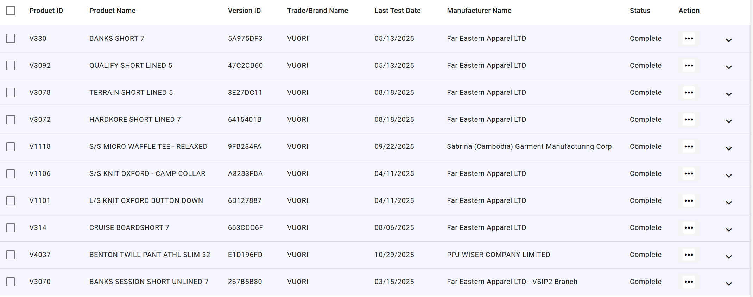
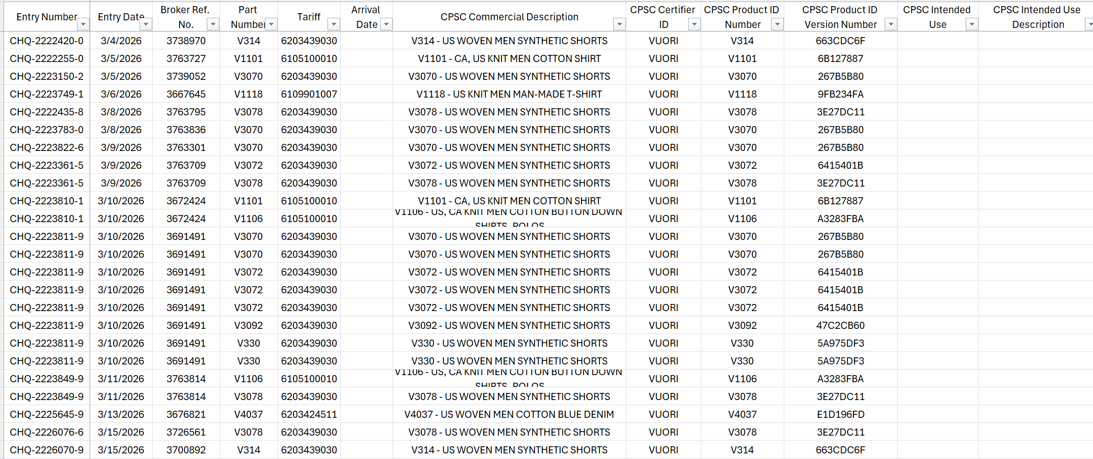
We – Vuori is the Importer as Product‑based VS. Flexport is the Logistic that Shipment‑based
Vuori Submitted on ACE
Data gained from Flexport
From Vuori’s perspective as the Importer of Record, our approach is product‑based. We create and maintain one CPSC Product ID per unique style (e.g., V3070), supported by the applicable GCC, test reports (including flammability), manufacturer information, and version control in ACE.
From Flexport’s perspective as our customs broker/logistics partner, we understand that entries are shipment‑based, meaning the same style may appear across multiple customs entries with different entry numbers and entry dates as shipments arrive into the U.S.
Using V3070 as an example, we see multiple entry dates (e.g., 03/05/2026, 03/08/2026, 03/09/2026, 03/10/2026). Our understanding is that these represent separate shipment events and do not require re‑creation or re‑certification of the same product profile in CPSC/ACE, provided that:
The product itself has not changed
The supply chain (manufacturer/factory) remains the same
The applicable flammability test report and other compliance documentation remain valid
Under these conditions, the same CPSC Product ID and GCC can be reused across multiple shipments, with Flexport referencing the existing Product ID at the entry level.

Slide 13
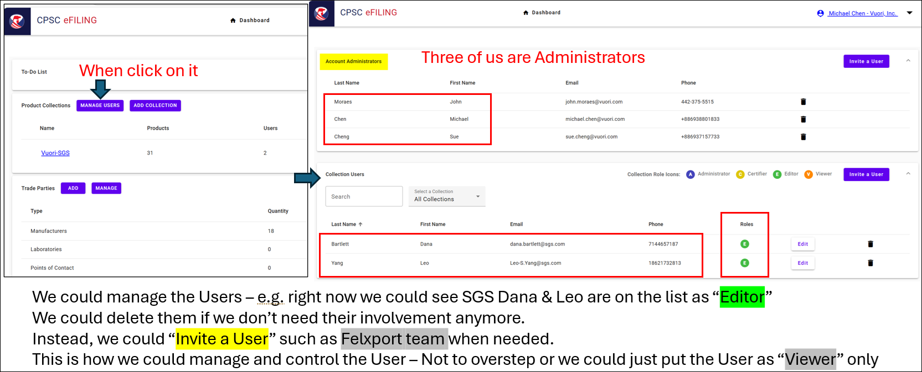
REMARKS-1
MANAGE USERS

Slide 14
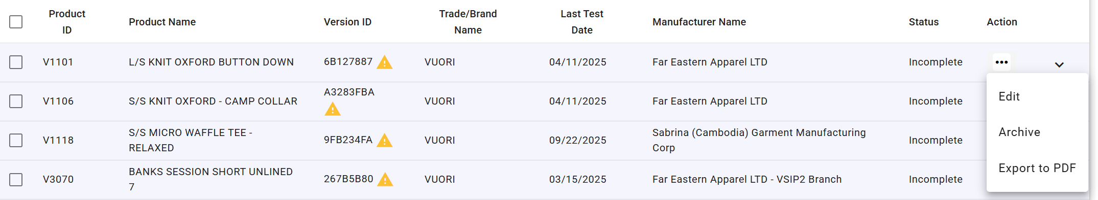
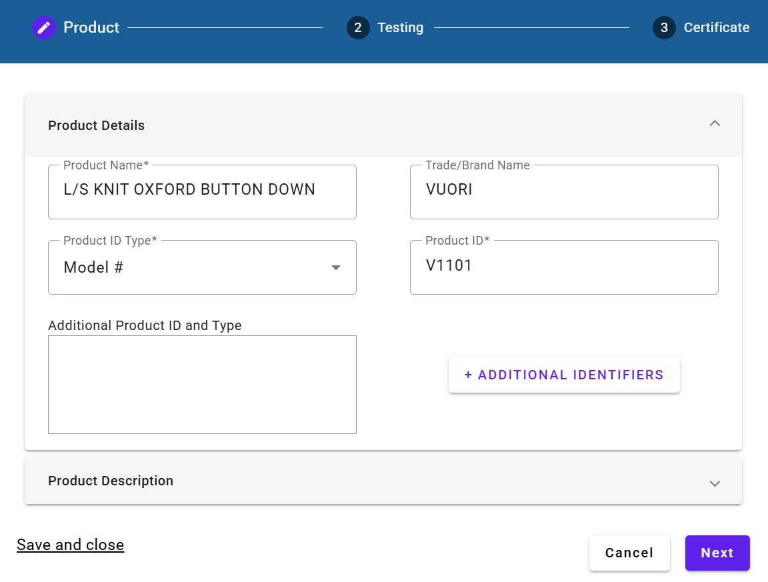
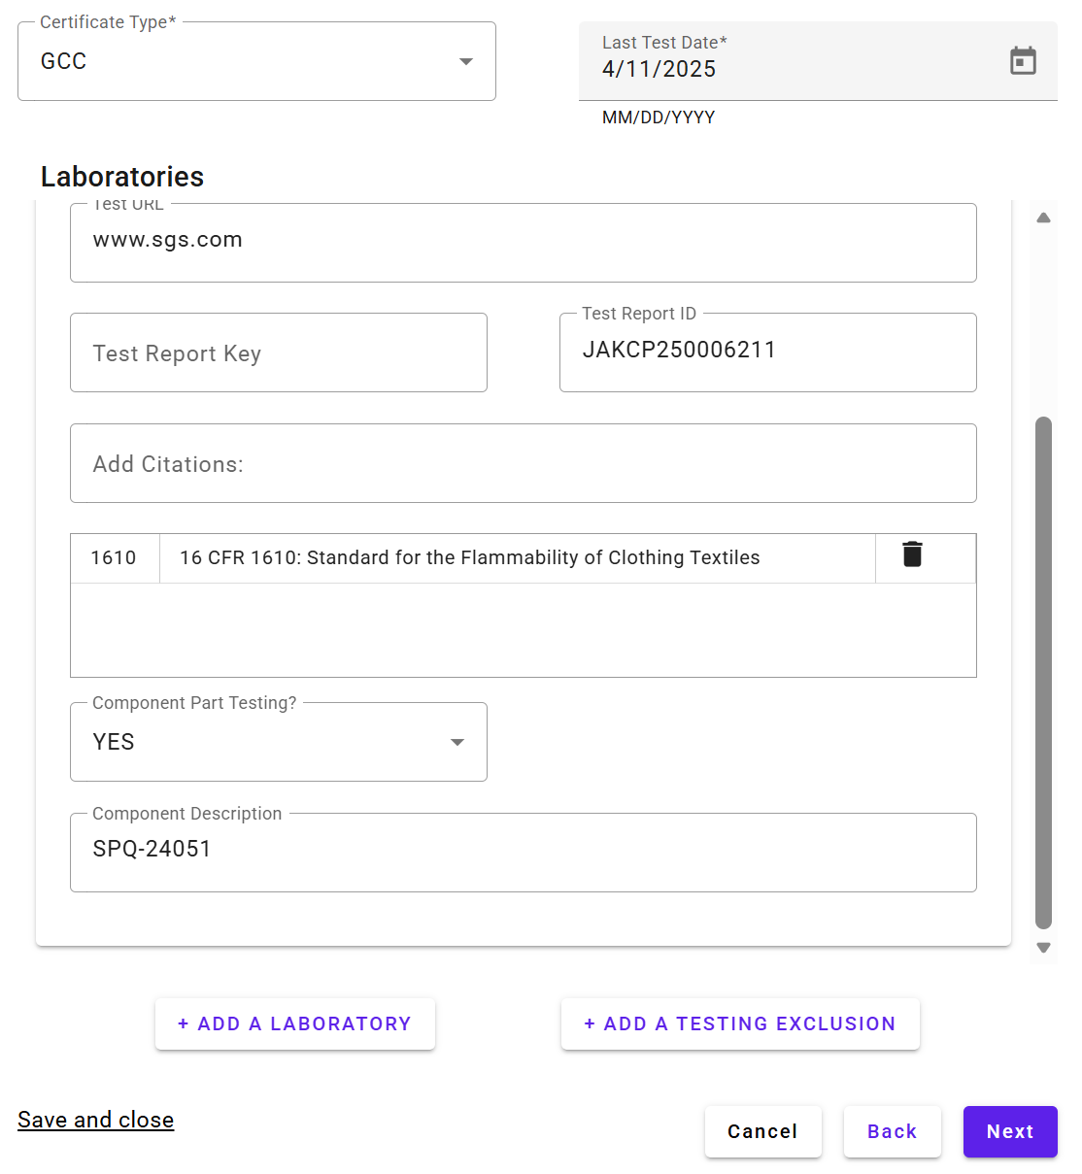
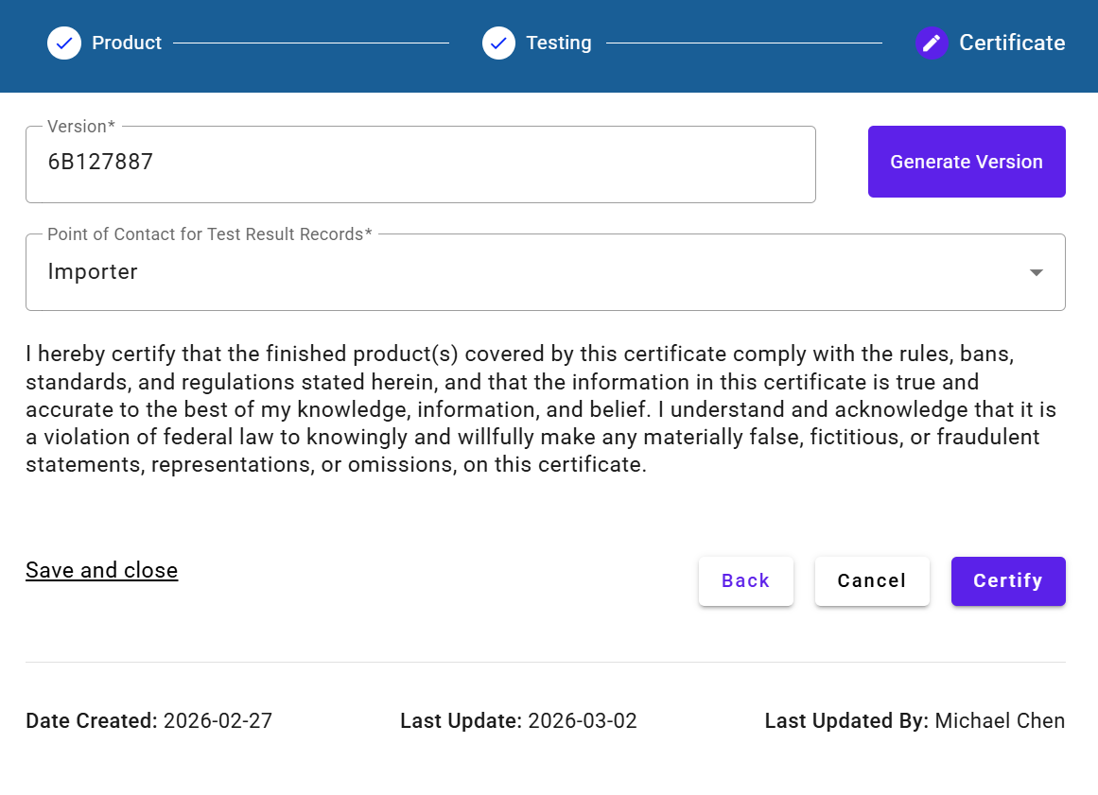




REMARKS-2
STEP BY STEP
1.
2.
5.
6.
3.
4.

Slide 15
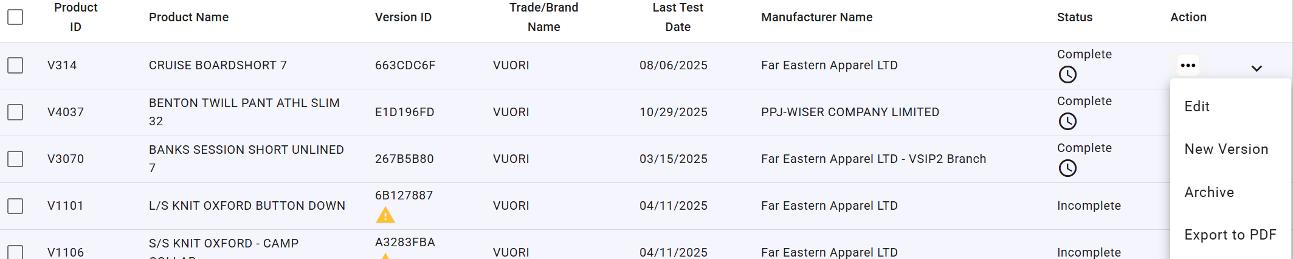

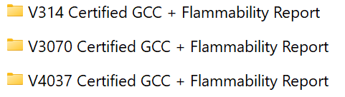




REMARKS-3
Inside of our Shared Holder:
It’s for GCC downloading

Slide 16
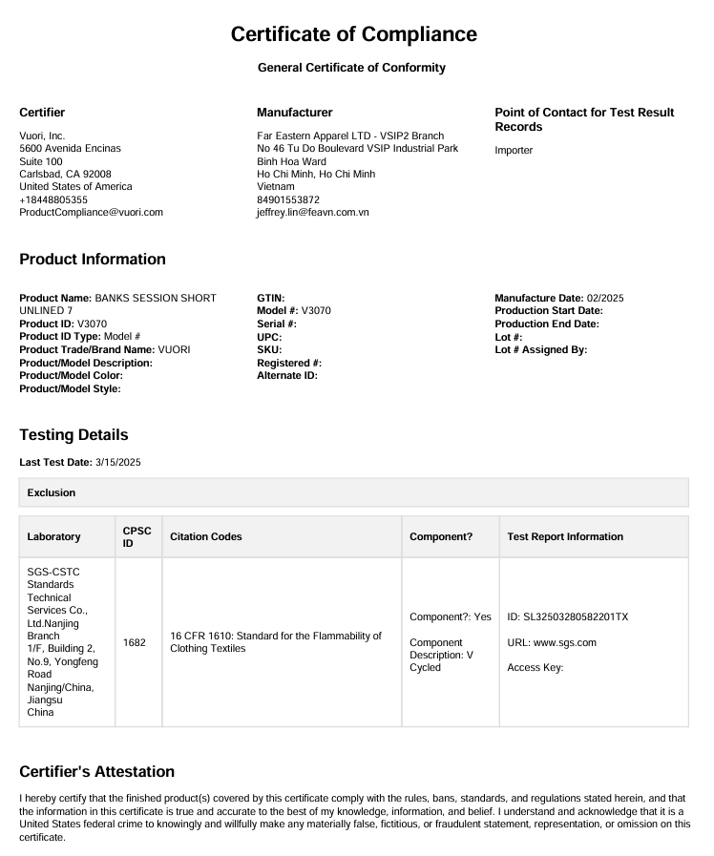
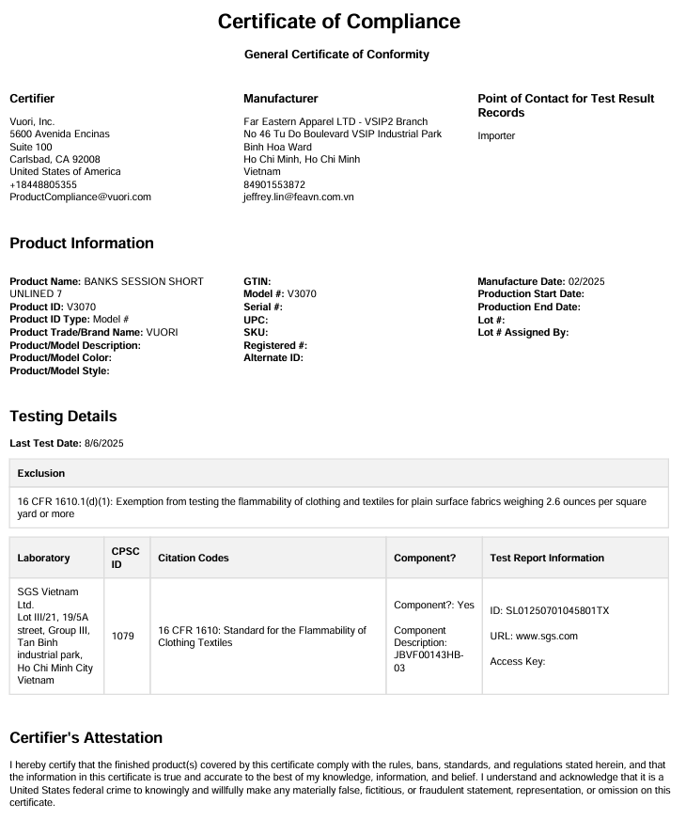





















1st Version
2nd Version

